Slide 1
Clustering Building Tools
Saurabh Ninave
CDAC, Pune
© 2010, Centre for Development of Advanced Computing, Pune

Slide 2
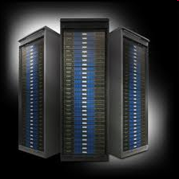
Agenda
Definition
Software stack
Software stack components
Component support
Cluster tools
xCAT
OSCAR
Rocks
Inclus
© 2010, Centre for Development of Advanced Computing, Pune

Slide 3
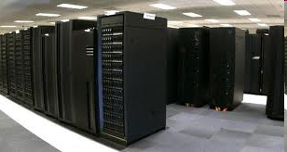
Clustering tool
A clustering tool allow a group of linked computers, to work together closely thus in many respects forming a single computer.

Slide 4
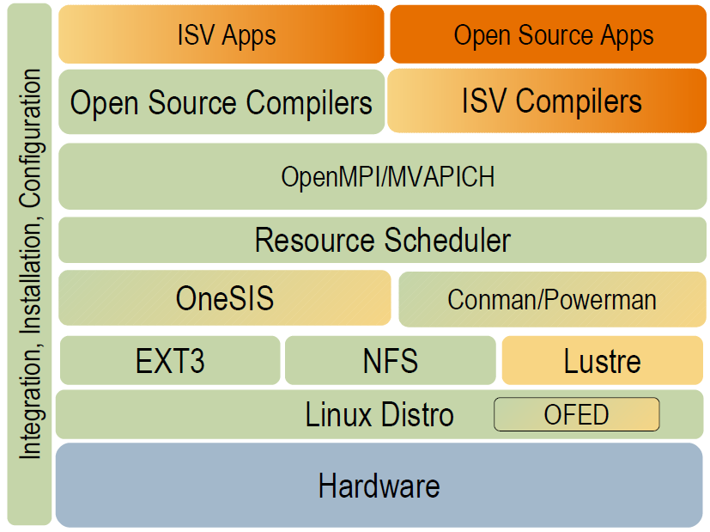
Software stack

Slide 5
Software stack components
Schedulers
PBS
SGE
LSF
MOAB
Slurm
Libraries
OFED
OpenMPI
LaPACK, Atlas
Compilers & Debuggers
Intel
AMD
PGI
Totalview
OS/Kernel space
CentOS
Luster
OSS/MDS
Sam-QFS

Slide 6
Software stack components Cont.
Verification Modules
Lozone3
IOR
NetPipe
HPCC Benchmarking
IOkit
LNET Self Test
Adapters
Ethernet
Mellanox IB
SATA
Fiber channel
Graphics/VIZ
GPGPU

Slide 7
Software stack components Cont.
HW platform
SW RAID
Constellation
Galaxy/blade/etc. technologies
Switch
Drivers including OFED
Node
ILOM
IPMI-based
Service processors
Power on/off
BIOS integration

Slide 8
Component Support
Open Softwares
CentOS(RHEL)
GNU Compiler collection
IPMItool
OpenSM
Product Support
Server OEM's
LNET
Self Test
IOKit
3rd Party ISV
TotalView
PGI Compiler
Intel Compiler
LSF
PBS
MOAB Cluster Resources
Verification Modules
Community
SLURM Ganglia OpenMPI
OneSIS CFEngine
FreeIPMI pdsh OFED
Conman Powerman
NetPIPE
HPCC Bench Suit
Iozone3 IOR

Slide 9





Some Cluster tools
xCAT
OSCAR
Rocks
InClus

Slide 10
xCAT
xCAT (Extreme Cluster Administration Toolkit) is open-source distributed computing management software used for the deployment and administration of clusters.
It can:
create and manage diskless clusters
install and manage many Linux cluster machines in parallel
set up a high-performance computing software stack, including software for batch job submission, parallel libraries, and other software that is useful on a cluster
cloning and imaging Linux and Windows machines

Slide 11
Features
xCAT has specific features designed to take advantage of IBM hardware including:
Remote Power Control
Remote POST/BIOS console
Serial over LAN functions
Hardware alerts and vitals provided via SNMP and EMAIL
Inventory and hardware management

Slide 12
Features
Easy to deploy
Easy to manage
Easy to use
Open
Flexible
Optimized
Certified
Expandable
Supported
Notes:
Complete
A rich set of software kits
Common HPC tools included
Web-based management
Portal, job submission & management built-in
Cluster monitoring, alerting and reporting
Everything you need is here
No hidden costs or deployment surprises
Deploy optimized clusters quickly and predictably
No need to waste time installing and configuring add-on components
Easy to deploy
From bare-metal to a functioning HPC cluster in one hour
Software is installed and configured automatically
Cluster nodes are easily added and managed using the web interface
Save time, reduce effort
Start using your cluster faster
Reduce your reliance on external consultants or busy Linux administrators
Easy to manage
Change node group definitions with ease
Maintain multiple software versions with repository snapshots
Install patches and software packages without re-provisioning
Patch new device drivers into repositories
Graphical views for monitoring clusters and flagging potential issues
Be more responsive to your cluster users
Take the risk out of software upgrades
Easily roll-back changes
Reduce cluster downtime
Support future hardware without upgrading the installer node
No need to hand edit XML templates or shell scripts
Easy to use
Submit jobs directly through the portal
Manage workloads and job status through the web interface
Reduced end user training requirements
Reduce job submission errors
Limit access to the cluster based on identity and role
Administrators spend less time supporting cluster users
Open
Based on the open source Project Kusu
Supports multiple standard provisioning methods
Your choice of supported Linux OS
No proprietary “lock-in”
Multiple sources of supply and support
Cost-effective to acquire and manage
Best of both worlds – open software with optional commercial components and support
Flexible
Deploy multiple OS environments to the same cluster
Support real-world network topologies
Synchronize cluster files without re-installing
Optional command line interfaces
Support for the NVIDIA® CUDA™ Parallel Computing environment
Maintain a library of available operating systems and software stacks
Change software configurations at any time
Expand the cluster easily
Customize the environment
Easily exploit the power of advanced graphic processing units (GPUs) for general purpose HPC calculations
Optimized
Optimized for simplicity and performance
Libraries pre-compiled and tuned for the latest hardware and interconnects
Realize better performance “out of the box”
Maximize application level performance
Save time avoiding the need to search the net for the latest drivers or math libraries
Certified
Used to deploy certified Intel® Cluster Ready Systems
Pre-engineered and tested on select hardware configurations
Simplifies Linux cluster application, deployment and management by providing pre-configured, certified clusters
Expandable
Add cluster nodes at any time “on the fly”
Easily upgrade to Platform LSF
A wealth of commercial add-on solutions to accommodate cluster growth in size and sophistication
Easily add new, future hardware models
Platform LSF has proven scalability to 10,000+ CPUs
Supported
Single point of contact for a fully integrated hardware & software solution
Software updates included
7x24 enterprise support from the industry’s highest regarded HPC support organization
Enjoy peace of mind with a fully supported solution backed by the best in the business

Slide 13
OSCAR
OSCAR (Open Source Cluster Application Resources) is a snapshot of the best known methods for building, programming, and using clusters. It consists of a fully integrated and easy-to-install software bundle designed for high performance cluster computing.

Slide 14
Rocks
Rocks Cluster Distribution is a Linux distribution intended for high-performance computing clusters.
Based on the Red Hat Linux distribution.
Cluster on a DVD ( or set of CDs)
Goals of Rocks
Make Clusters Easy
Reduce dependence on system administrators by reducing system administration
Enable scientists to concentrate on science rather than on computing.

Slide 15
Rolls
Alpha
Area51
Base
Bio
Condor
Ganglia
Grid
hpc
Java
kernel

Slide 16
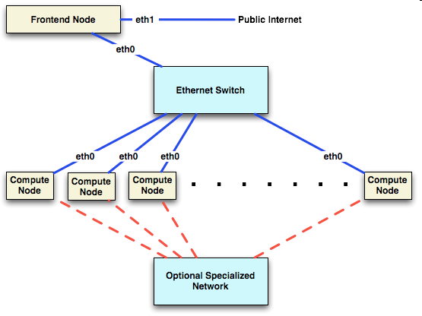
Architecture

Slide 17
Installing Rocks
Rocks provides for installation of a cluster with minimum user interaction
Steps involved
Boot from CD or DVD
Answer a few questions
Get favorite beverage
You’re on your way to a full fledged cluster in 2 hours or less.

Slide 18
Innards of Automatic Installs
Rocks uses Redhat’s Kickstart mechanism for automated installs
Kickstart file generated and given to the installer
Installer follows instructions in Kickstart file.
Generation of Kickstart file done automatically by Rocks scripts

Slide 19
The Head Node
Users login, submit jobs, compile code, etc
Uses two Ethernet interfaces
one public, one private for compute nodes
Normally has lots of disk space
(system partitions < 30 GB)
Provides many system services
NFS, DHCP, DNS, MySQL, HTTP, 411, Firewall,etc
Cluster configuration
Notes:
Basic OS file system takes 13 GB of disk space not including the /export which is used for home directories and installation directories.
LVM is not supported in ROCKS.
ss

Slide 20
Compute Nodes
Basic compute workhorse
Lots of memory (if lucky)
Minimal storage requirements
Single Ethernet connection for private LAN
Disposable
OS easily re-installed from head node
Nodes can be heterogeneous

Slide 21
NFS in ROCKS
User accounts are served over NFS
Works for small clusters (< 128 nodes)
Will not work for large clusters (>1024)
NAS tends to work better
Applications are not served over NFS
/usr/local does not exist
All software is installed locally (/opt)

Slide 22
411 Secure Information Service
Provides NIS-like functionality
Securely distributes password files, user and group configuration files and the like using Public Key Cryptography to protect file content.
Uses HTTP to distribute the files
Scalable, secure and low latency

Slide 23
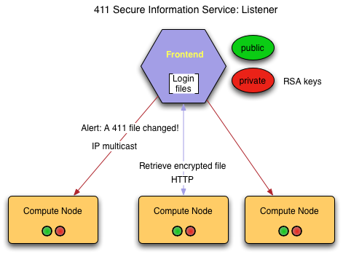
411 Architecture
Client nodes listen on the IP broadcast address for “411 alert” messages from the head node.
Nodes then pull the file from the head node via HTTP after some delay to avoid flooding the master with requests.

Slide 24
Ganglia Monitoring
Ganglia is a scalable distributed monitoring system for high-performance computing systems such as clusters and grids
It leverages widely used technologies such as XML for data representation, XDR for compact, portable data transport, and RRDtool for data storage and visualization.
It uses carefully engineered data structures and algorithms to achieve very low per-node overheads and high concurrency.
Provides a heartbeat to determine compute node availability.
Notes:
XDR External Data Representation standard
RRDtool Data logging and graphing application.
RRD is the acronym for Round Robin Database. It is a system to store and display time-series data.
(ie network bandwidth, server load average, machine temps, etc)
XML Extensible Markup Language

Slide 25
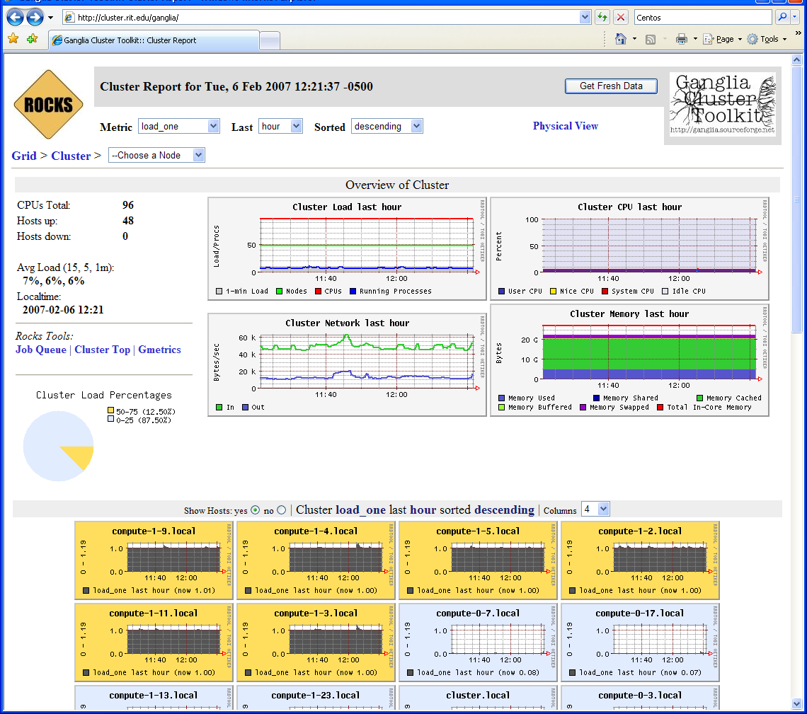
Cluster Status with Ganglia

Slide 26
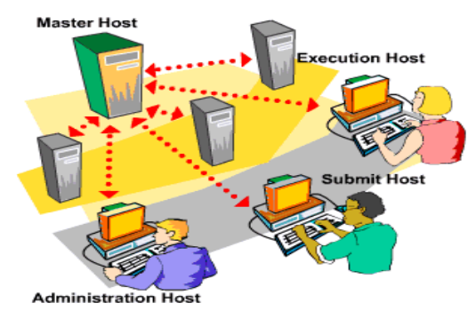
Sun Grid Engine (SGE)
SGE is resource management software
Accepts jobs submitted by users
Schedules them for execution on appropriate systems based on resource management policies
Can submit 100s of jobs without worrying where it will run
Supports serial as well as parallel jobs

Slide 27
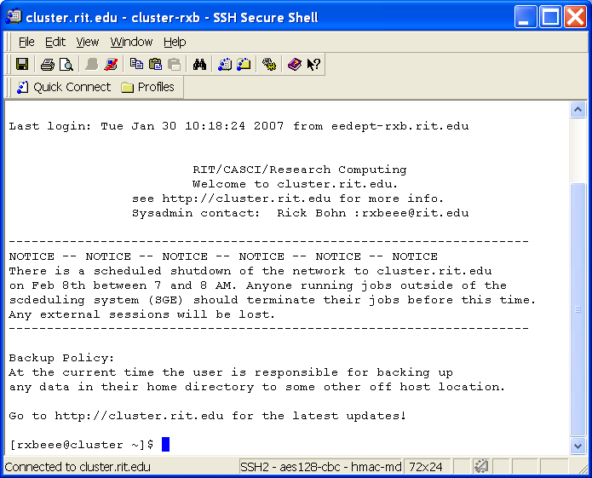
Accessing the Cluster
Access the cluster via an SSH client
PuTTY
SSH Secure Shell
X-Win32
F-Secure
To transfer data to the cluster use either scp or sftp.
Windows users can download and use WinSCP (http://winscp.net)

Slide 28
Integrated Cluster Solution (InClus) is Cluster management and monitoring software. InClus approaches the need of technical challenges in field of HPC,
It makes cluster easy. With help of InClus we can easily Install, manage and monitor HPC clusters. InClus is very effective and versatile solution in field of HPC.
With web based interface building cluster was never so easy. It helps organizations to concentrate on their application/research work instead of troubleshooting and configuring clusters.
© 2010, Centre for Development of Advanced Computing, Pune

Slide 29
InClus Features
Provision of Operating Systems on physical as well as virtual machines: RHEL5.x,
RHEL 6, CentOS5.x, CentOS6.x,
Cluster Management GUI: Web.
Development platform; Compilers, Debuggers
Scheduler and resource manager
Policy based accounting
© 2010, Centre for Development of Advanced Computing, Pune

Slide 30
InClus Features
Remote console. Powerful shell support.
Quickly set up and control Management node services: DNS, HTTP, DHCP, TFTP
User Management.
GPU Support.
Log monitoring
Critical Error/ Warning reporting via Web interface
SMS/Mail alerts for checking job status
© 2010, Centre for Development of Advanced Computing, Pune

Slide 31
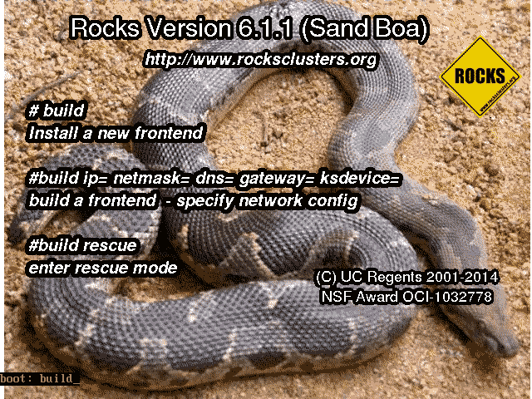
1. After the frontend boots off the DVD, you will see:
When you see the screen above, type: build

Slide 32
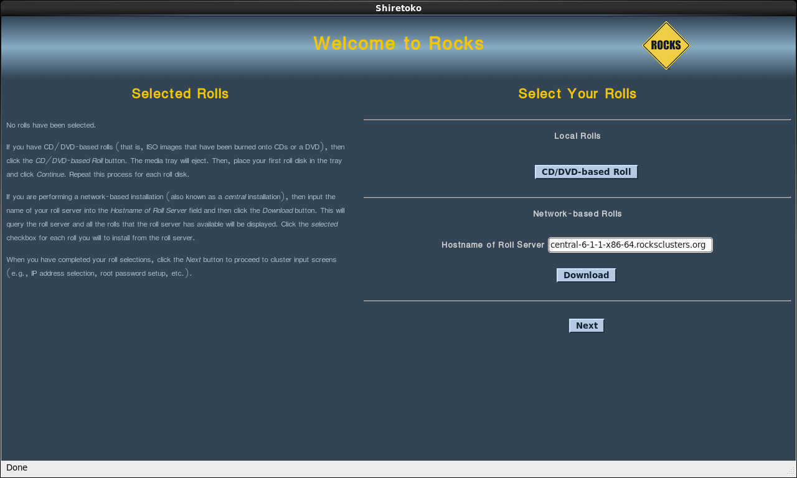
2. Soon, you’ll see a screen that looks like:

Slide 33
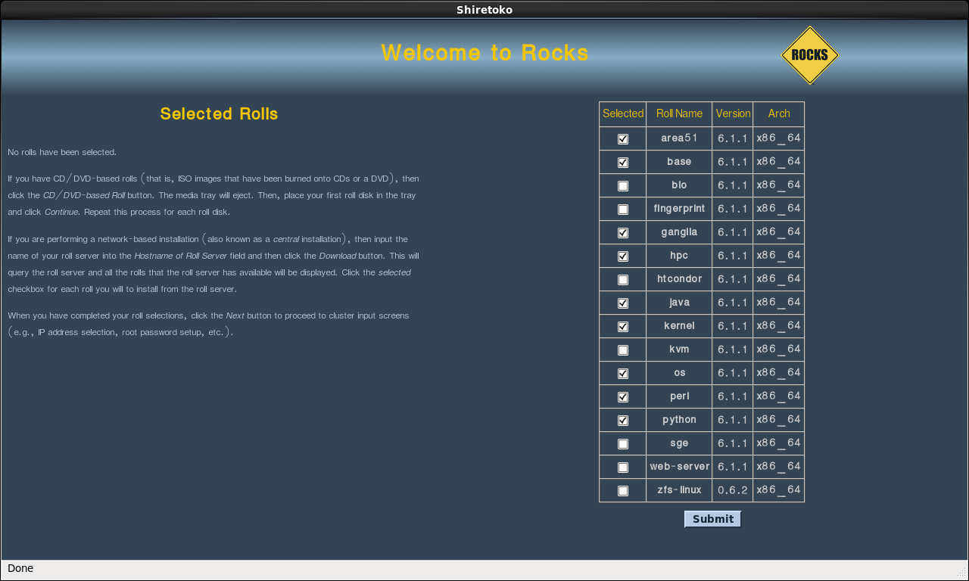
3. From this screen, you’ll select your rolls:

Slide 34
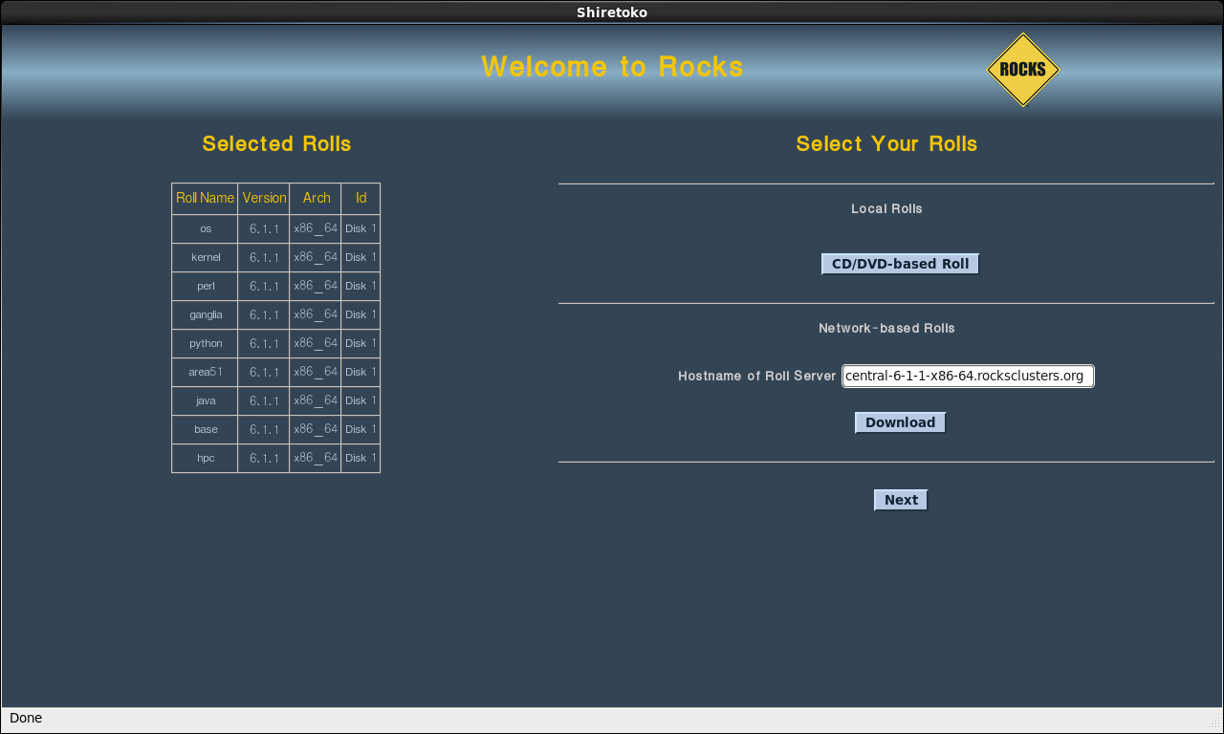
4. When you have selected all the rolls associated with a bare-bones frontend, the screen should look like:
When you are with roll selection, click the 'Next' button.

Slide 35
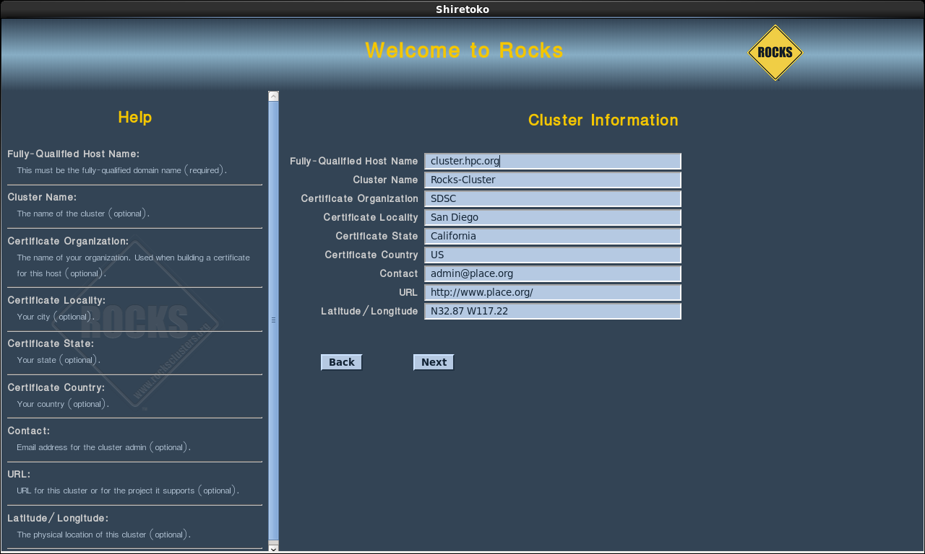
5. Then you'll see the Cluster Information screen:
The one important field in this screen is the Fully-Qualified Host Name (all other fields are optional). Choose your hostname carefully.

Slide 36
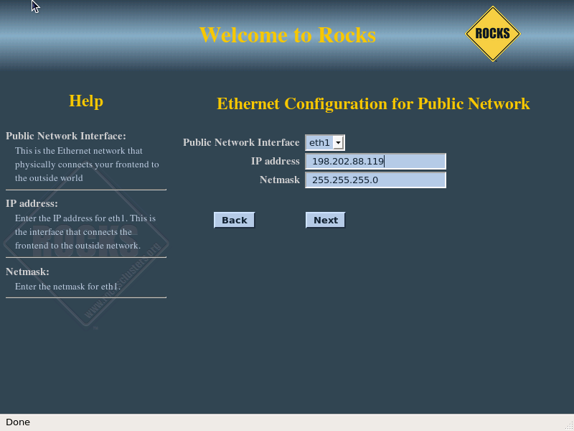
6. The public cluster network configuration screen allows you to set up the networking parameters (e.g., the internet):
The above window is an example of how we configured the external network on one of our frontend machines.

Slide 37
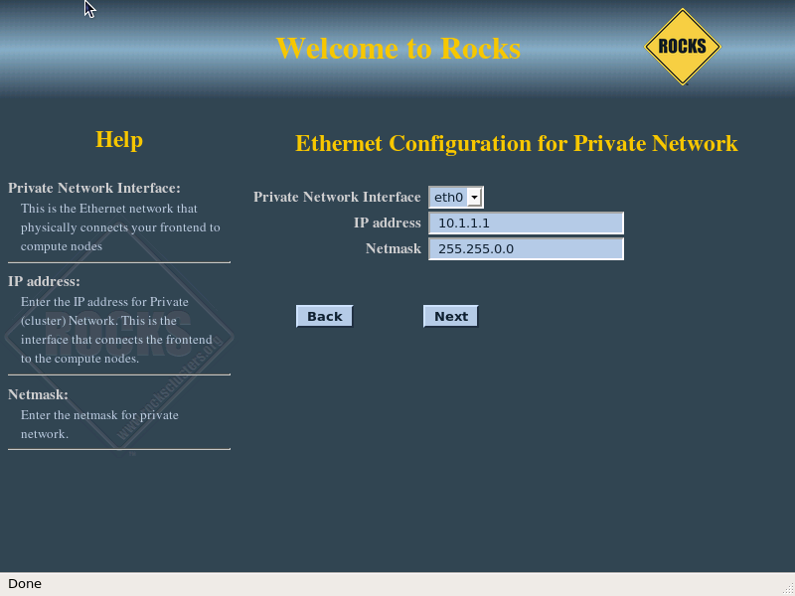
7. The private cluster network configuration screen allows you to connects the frontend to the compute nodes:
It is recommended that you accept the defaults (by clicking the ’Next’ button).

Slide 38
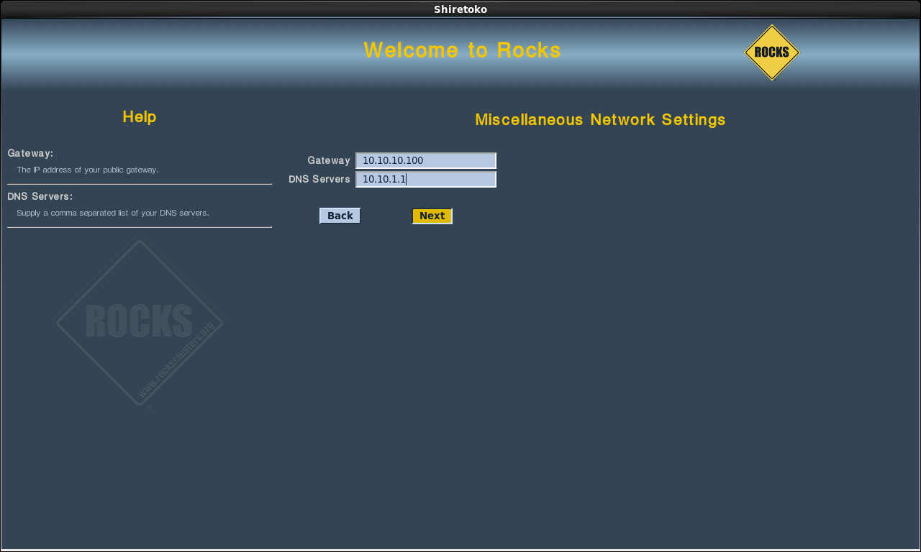
8. Configure the Gateway and DNS entries:

Slide 39
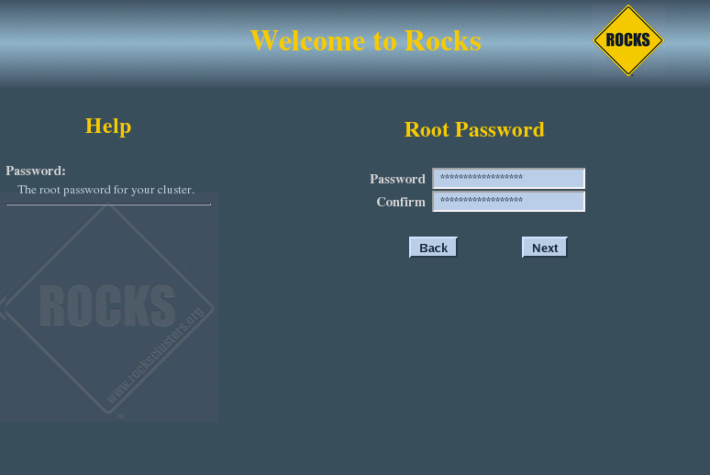
9. Input the root password:

Slide 40
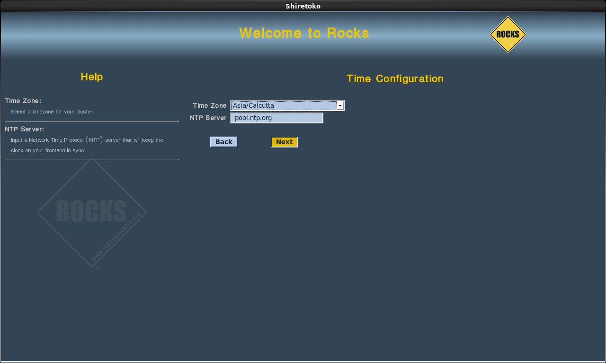
10. Configure the time:

Slide 41
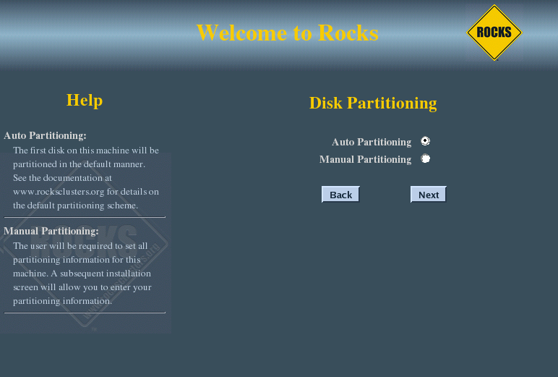
11. The disk partitioning screen allows you to select automatic or manual partitioning:
To select automatic partitioning, click the Auto Partitioning radio button. This will repartition and reformat the first discovered hard drive that is connected to the frontend.

Slide 42
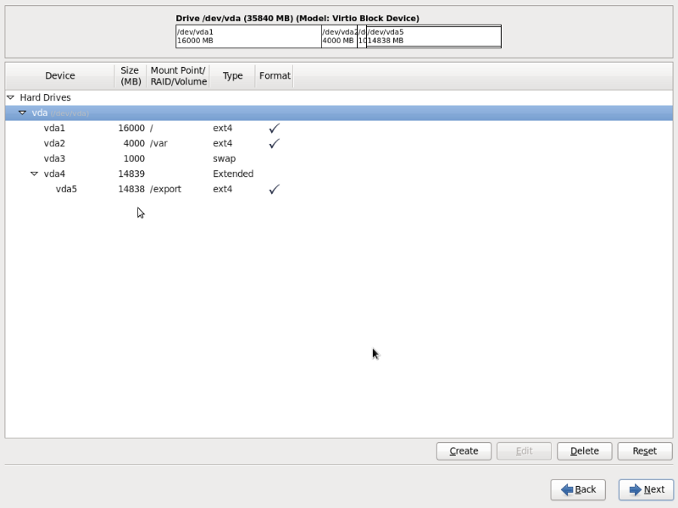
12. If you selected manual partitioning, then you will now see Red Hat’s manual partitioning screen:

Slide 43
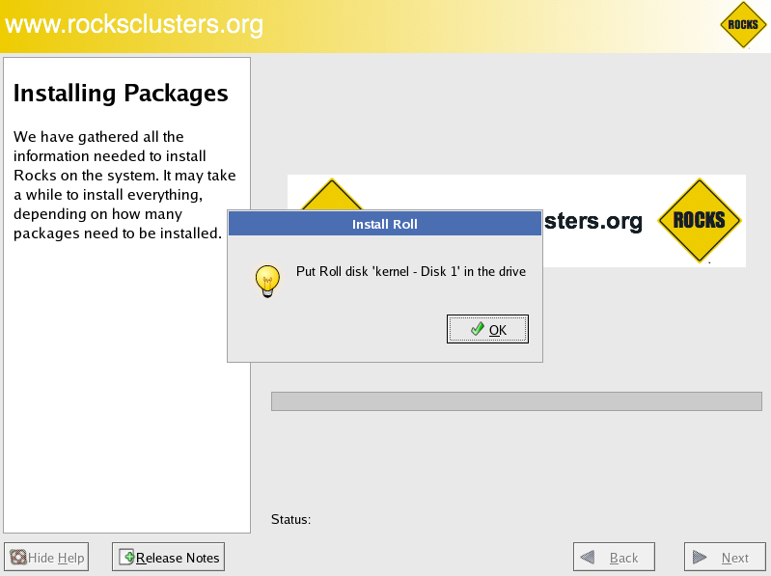
13. The frontend will format its file systems, then it will ask for each of the roll CDs you added at the beginning of the frontend installation:

Slide 44
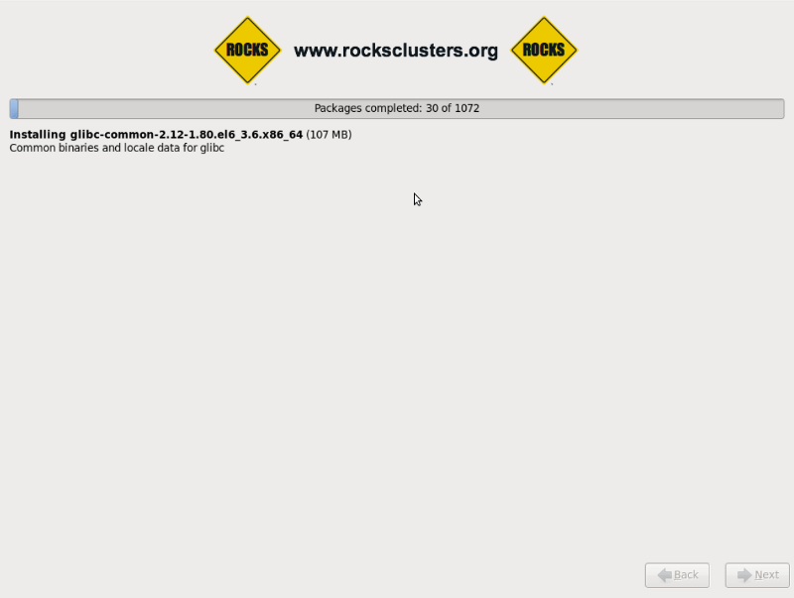
14. After the last roll CD is copied, the packages will be installed:
Finally, the boot loader will be installed and post configuration scripts will be run in the background.

Slide 45
After Frontend Installation

Slide 46
Install Your Compute Nodes
Login to the frontend node as root.
Run the program which captures compute node DHCP requests and puts their information into the Rocks MySQL database:
# insert-ethers

Slide 47
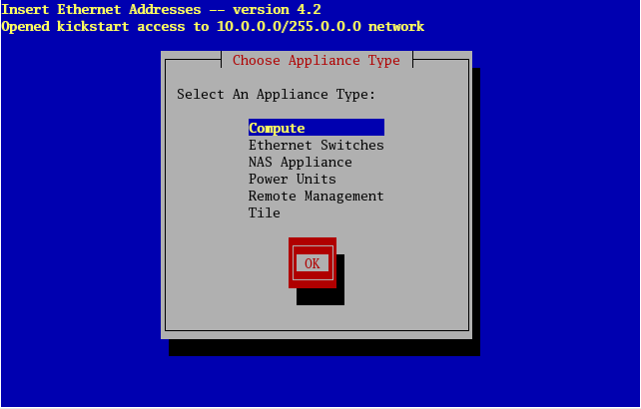
This presents a screen that looks like:

Slide 48
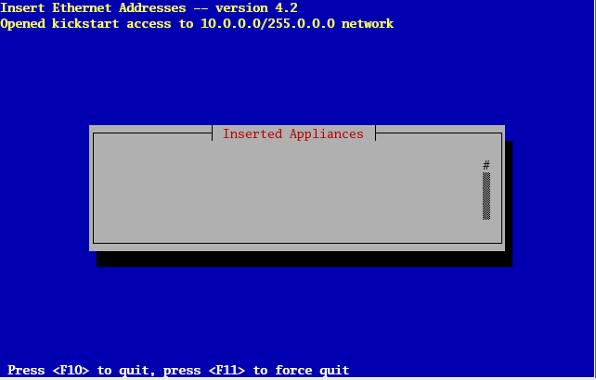
3.Then you’ll see:
This indicates that insert-ethers is waiting for new compute nodes.

Slide 49
4. Power up the first compute node:
The BIOS boot order of your compute nodes should be: CD, PXE (Network Boot), Hard Disk.
If your compute nodes don’t support PXE, then you’ll need to boot your compute nodes with the Kernel
Roll CD.
If you don’t have a CD drive in your compute nodes and if the network adapters in your compute nodes
don’t support PXE, see Using a Floppy to PXE boot.

Slide 50
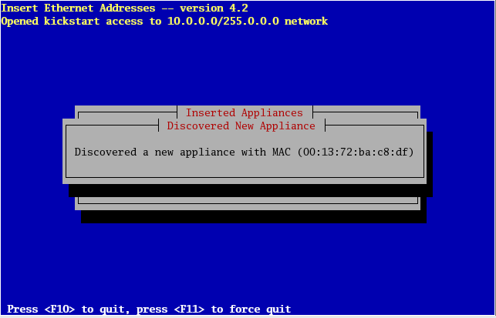
5. When the frontend machine receives the DHCP request from the compute node, you will see something similar to:
This indicates that insert-ethers received the DHCP request from the compute node, inserted it into the database and updated all configuration files (e.g., /etc/hosts, /etc/dhcpd.conf and DNS).

Slide 51
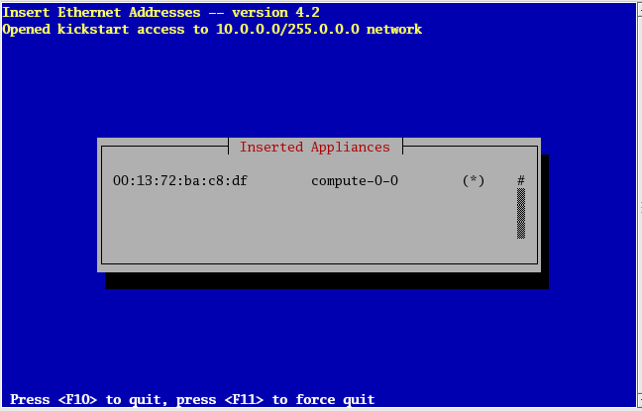
6.The above screen will be displayed for a few seconds and then you’ll see the following:

Slide 52
7. At this point, you can monitor the installation by using rocks-console. Just extract the name of the installing compute node from the insert-ethers output (in the example above, the compute node name is compute-0-0), and execute:
# rocks-console compute-0-0
8. After you’ve installed all the compute nodes in a cabinet, quit insert-ethers by hitting the ’F8’ key.
9. After you’ve installed all the compute nodes in the first cabinet and you wish to install the compute nodes in the next cabinet, just start insert-ethers like:
# insert-ethers --cabinet=1
This will name all new compute nodes like compute-1-0, compute-1-1, ...

Slide 53
Thank You
© 2010, Centre for Development of Advanced Computing, Pune

